Slide 1
MEETING 12
Reading Comprehension
Vocabulary Questions

Slide 2
Objectives:
At the end of this course the students are expected to be able to:
Understand how to relate words with contexts
Identify the context of sentence containing difficult words
Guess meaning using contexts

Slide 3
FIND DEFINITION FROM STRUCTURAL CLUES
When you are asked to determine the meaning of a word in the reading section of TOEFL test, it is possible that the passage provides information about the meaning of the word, and that there are structural clues to tell you that the definition of a word is included in the passage.

Slide 4
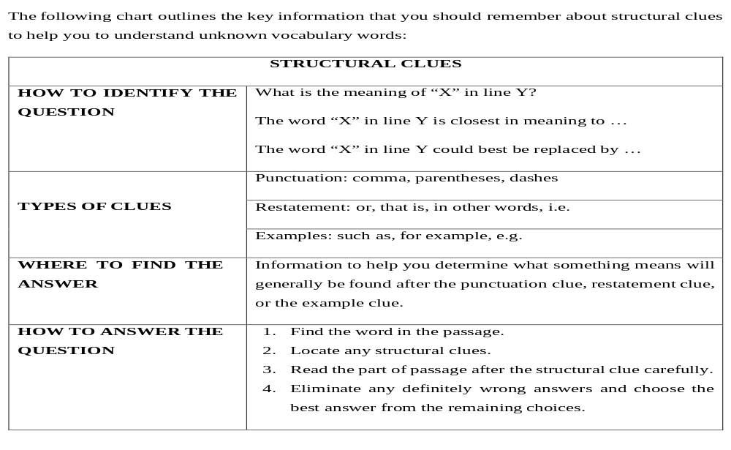

Slide 5
Passage 1.
A supernova occurs when all of the hydrogen in the core of a huge star is transformed to iron and explodes. All stars die after their nuclear fuel has been exhausted. Stars with little mass die gradually, but those with relatively large mass die in a sudden explosion, a supernova. The sudden flash of light can then be followed by several weeks of extremely bright light, perhaps as much light as twenty million stars.
Supernovae are not very common; they occur about once every hundred years in any galaxy, and in 1987 a supernova that could be seen by the naked eyed occurred in the Magellan Cloud, a galaxy close to the Milky Way. Scientists periodically detect supernovae in other galaxies; however, no supernovae have occurred in the Milky Way (the galaxy that includes Earth) since 1604. One very impressive supernova occurred in the Milky Way on July 4, 1054. There was a great explosion followed by the three months of lighted skies, and historical chronicles of the time were full of accounts and unusual explanations for the misunderstood phenomenon-many people believed that it meant that the world was coming to an end.

Slide 6
1. A “supernova” in line 1 is which of the following? a.The iron component of a star b.The core of a star c. The hydrogen in a star d. The explosion of a star
2. According to the passage, which of the following best describes the “Magellan Cloud” in paragraph 2?
A. A galaxy inside the Milky Way b. A cloud composed of hydrogen c. A galaxy near Earth’s galaxy d. A cloud in the sky above the Earth
3. Look at the expression Milky Way in paragraph 2. The Milky Way is a. Part of Earth b. A galaxy close to Earth c. The galaxy that is home to Earth d. A creamy-colored cloud in the sky

Slide 7
PASSAGE 2
The teddy bear is a child’s toy, a nice soft stuffed animal suitable for cuddling. It is, however, a toy with an interesting history behind it.
Theodore Roosevelt, or Teddy as he was commonly called, was president of the United States from 1901 to 1909. He was an usually active man with varied pastimes, one of which was hunting. One day the president was invited to take part in a bear hunt; and inasmuch as Teddy was president, his hosts wanted to ensure that he caught a bear. A bear was captured, clanked over the head to knock it out, and tied to a tree; however, Teddy, who really wanted to hunt a bear, refuse to shoot the bear and, in fact, demanded that the bear be extricated from the ropes; that is, he demanded that the bear be set free.
The incident attracted a lot of attention among journalists. First a cartoon-drawn by Clifford
K. Berryman to make fun of his situation-appeared in the Washington Post, and the cartoon was widely distributed and reprinted throughout the country. Then toy manufactures began producing a toy bear which they called a “teddy bear.” The teddy bear became the most widely recognized symbol of Roosevelt’s presidency.

Slide 8
According to line 1 of the passage, what is a “teddy bear”?
  A ferocious animal
  The president of the United States
  A famous hunter
  A plaything
2. Look at the word “pastimes” in paragraph 2. This could best be replaced by
  Past occurrences
  Previous jobs
  Hunting trips
  Leisure activities
3. In paragraph 3, a “cartoon” could best be described as
  A newspaper
  A type of teddy bear
  A drawing with a message
  A newspaper article

Slide 9
DETERMINING MEANINGS FROM WORD PARTS
When you are asked to determine the meaning of a long word that you do not know in the reading section, it is sometimes possible to determine the meaning of the word by studying the word parts. It means it is important to have knowledge about the base or the root of the words, the morphemes, and their relatives, such as, affixes.

Slide 10
Here is a short list of word parts.
Part Meaning Example Part Meaning Example
Contra
against
contrast
Dict say dictation
Mal bad malcontent Domin master dominant
Miss
error
mistake
Jud judge judgment
Sub under subway
Mort
death
mortal
Dec ten decade
Spect see spectator
Multi many multiple
Terr earth territory
Sol one solo
Ver turn devert
Tri three triple
Viv live revive

Slide 11
PASSAGE 1
Ring Lardner himself was born into a wealthy, educated, and cultured family. For the bulk of his career, he worked as a reporter for newspaper in South Bend, Boston, St. Louis, and Chicago. However, it is for his short stories of lower middle-class Americans that Ring Landner is perhaps best known. In these stories, Ladner vividly creates the language and ambiance of this lower class, often using the misspelled words, grammatical errors, and incorrect diction that typified the language of the lower middle class.

Slide 12
1. The word “vividly” in the passage is closest in meaning to a. In a brief way b. In a lifelike way c. In a correct way d. In a cultured way
2. The word “misspelled” in the passage is closest in meaning to a. Quite vulgar b. Extremely wrong c. Highly improper d. Incorrectly written
3. The word “speech” in the passage is closest in meaning to a. Diction b. Ambiance c. Language d. Well written

Slide 13
PASSAGE 2
Checks and balances are an important concept in the formation of the U.S. system of government as presented in the Constitution of the United States. Under this conception of government, each branch of government has built-in checks and limitations placed on it by one or more different branches of government in order to ensure that any one branch is not able to usurp total dominance over the government. Under the Constitution, the United States has a tripartite government, with power divided equally among the branches: the presidency, the legislature, and the judiciary. Each branch is given some authority over the other two branches to balance the power among the three branches. An example of these checks and balances is seen in the steps needed to pass a law. Congress can pass a law with a simple majority, but the president can veto such a law. Congress can then counteract the veto with a two-thirds majority. However, even if Congress passes a law with a simple majority or overrides a presidential veto, the Supreme Court can still declare the law unconstitutional if it finds that the law is contradictory to the guidelines presented in the Constitution.

Slide 14
1. The expression "dominance over" in line 5 is closest in meaning to a. understanding of b. dispute over c. authority over d. rejection of
2. The word "tripartite" in line 6 suggests that something is a. divided into three b. totally democratic c. powerfully constructed d. evenly matched
3. The "judiciary" in line 7 is a. the electorate b. the authority c. the legal system d. the government

Slide 15
USE CONTEXT TO DETERMINE MEANINGS OF DIFFICULT WORDS
In reading comprehension, you may be asked to determine the meaning of a difficult word, a word that you are not expected to know. In this case, the passage will probably give you a clear indication of what the word means.

Slide 16
HOW TO IDENTIFY THE QUESTION | What is the meaning of “X” in line Y? The word “X” in line Y is closest in meaning to ….
WHERE TO FIND THE ANSWER | Information to help you understand the meaning of unknown word can often be found in the context surrounding the unknown word.
HOW TO ANSWER THE QUESTION | Find the word in the passage Read the sentence that contains the word carefully. Look at the context clues to help you understand the meaning. Choose the best answer that the context indicates.

Slide 17
PASSAGE 1
The black widow is the most dangerous spider living in the United States. It is most common in the southern parts of the country, but it can be found throughout the country. The black widow got its name because the female has been known to kill the male after mating and, as a result, becomes a widow.
The black widow is rather distinctive in appearance; it has a shiny globular body, the size and shape of a pea, and is marked on its underbelly with a red or yellow spot. The female is considerably more ample than the male, roughly four times larger on the average.
If a human is bitten by a black widow, the spider's poison can cause severe illness and pain. Black widow bites have occasionally resulted in death, but it is certainly not the norm for black widow bites to be mortal.

Slide 18
In line 4, the word "widow" means
  a type of poison
  the dead male spider
  the human victim of the spider
  a female whose mate has died
2. Which of the following is closest in meaning to the word "globular" in line 5?
  Earthen
  Luminescent
  Green in color
  Round
3. The word "ample" in line 7 indicates that the spider is
  feminine
  large in size
  dotted with colors
  Normal

Slide 19


